Slide 1

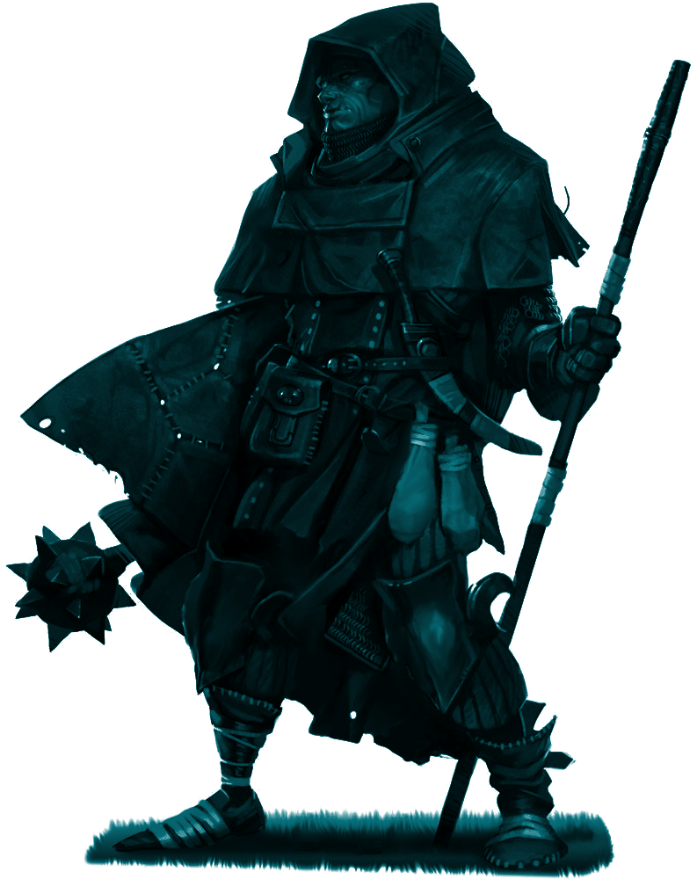

Generative Dungeon Crawler Game
Jared Tan, Leo Hanqing, Thu Ya
Notes:
Goal: Explain your project in 15 minutes

Slide 2
Outline
Brief History
Initial Design: UML Diagram
Combat Simulation
Menu Screen
Map Generation
Extras
Retrospection
References

Slide 3
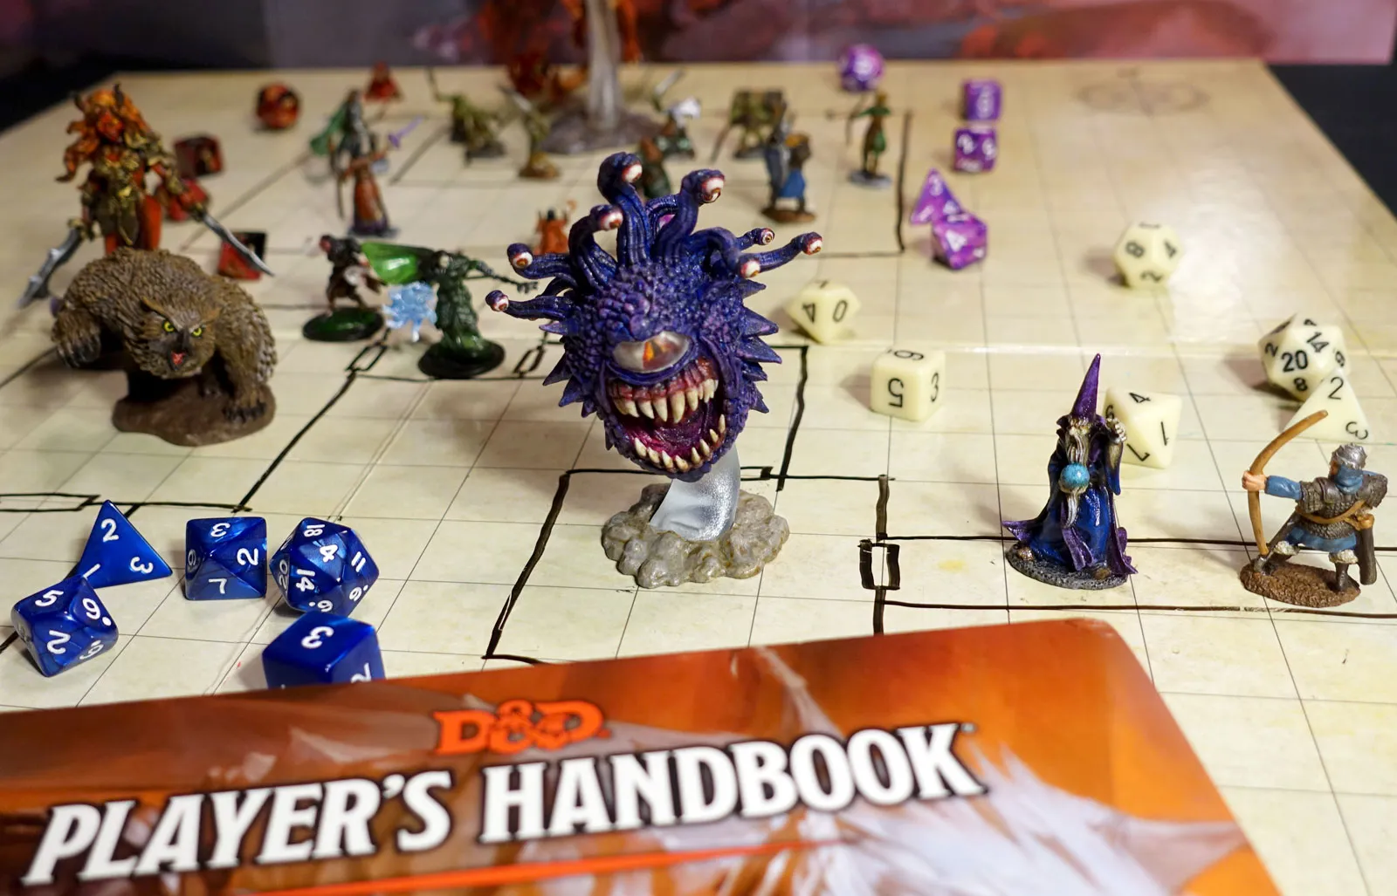
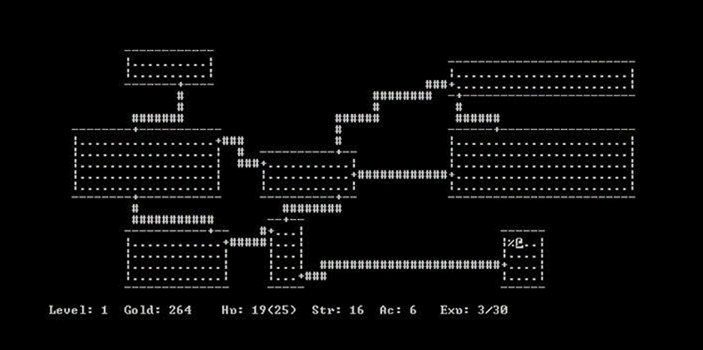
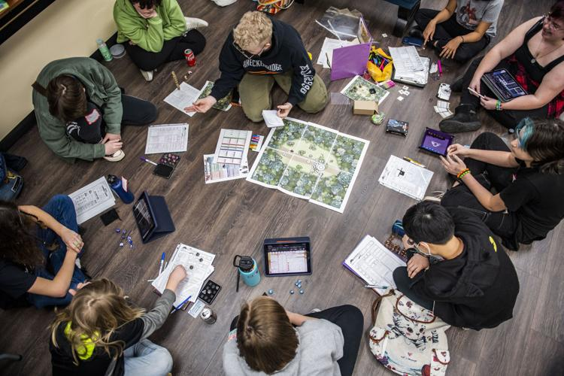
Brief History
Dungeons & Dragons - 1974
First revealed to the public by Gary Gygax and Dave Arnesan in 1974 as emphasized by Brewer Nathan (2016).
It’s a physical board game in which a person who is appointed as the ‘Dungeon Master’ narrates and distorts the story and the events within the game to the other remaining human players, who would interact with the characters and the revolving world using role-play.
The Dungeons - 1975
In 1975, the earliest recorded role-playing video game was displayed in the PLATO (Programmed Logic for Automatic Teaching Operations) which was the first generalized computer-assisted instruction system, located in the University of Illinois.
A game made by Rusty Rutherford in which a player-generated character would explore a premade dungeon and in each room, the player would encounter randomly generated enemies presented as fantasy monsters.

Slide 4
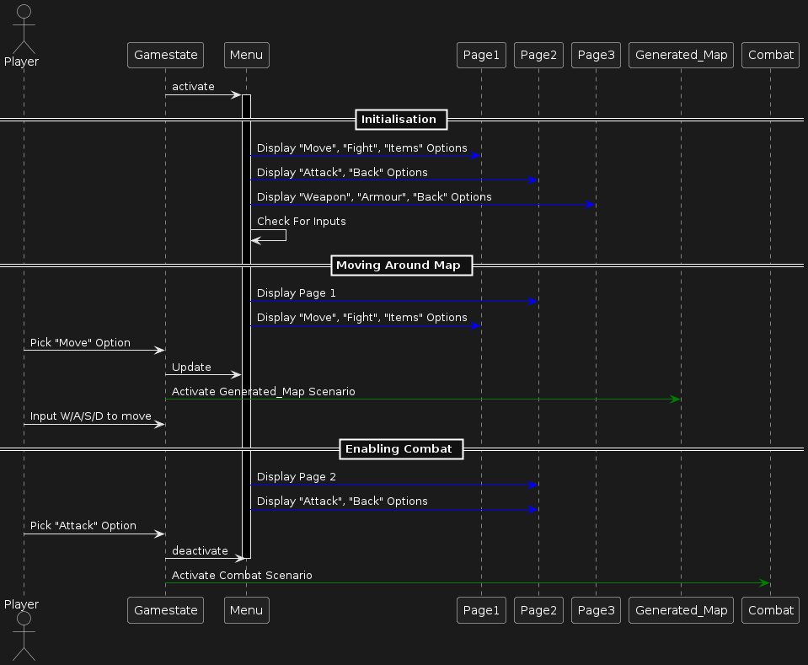
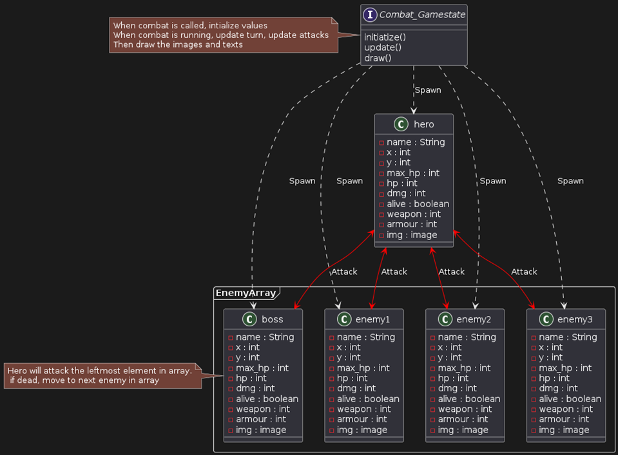
Initial Design: UML Diagram
Menu Gameplay Loop
Combat Simulation Class Interaction
Notes:
Fonts, colors, background, text size

Slide 5
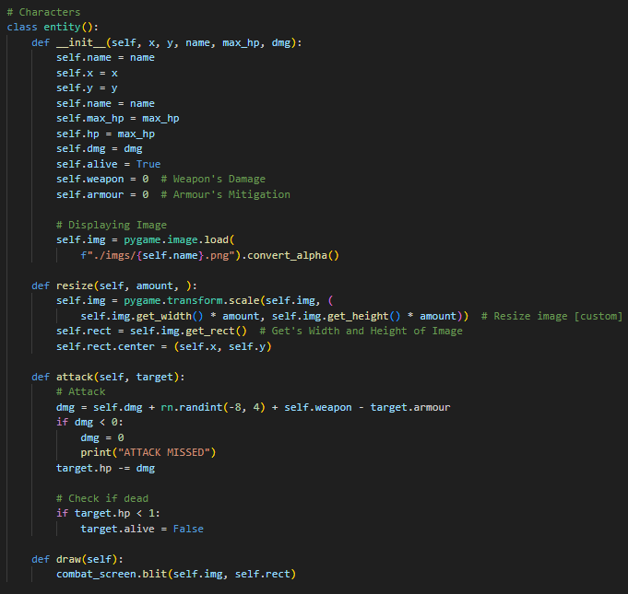
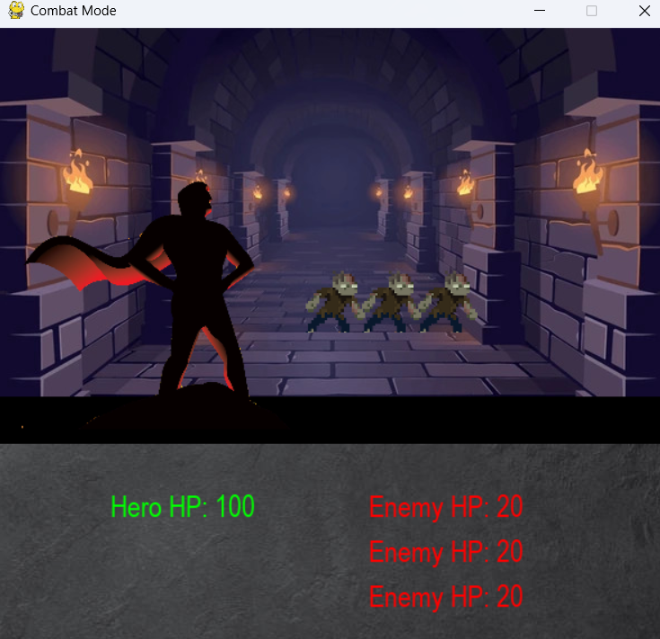
Combat Simulation: OOP

Slide 6
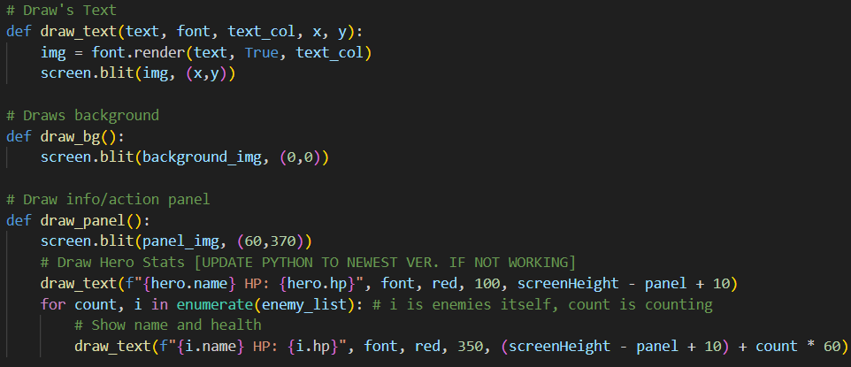
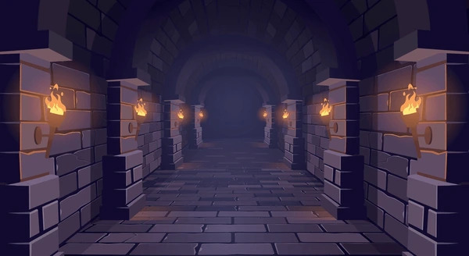

Combat Simulation: Graphics

Slide 7

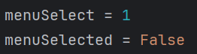
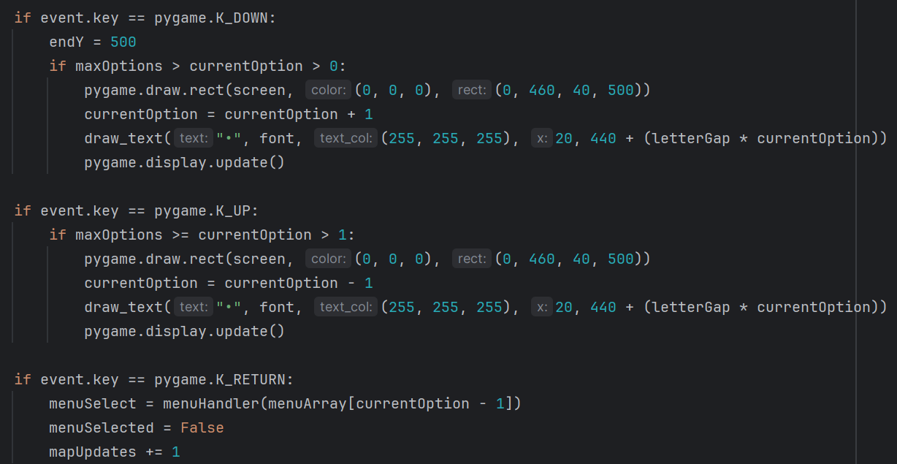
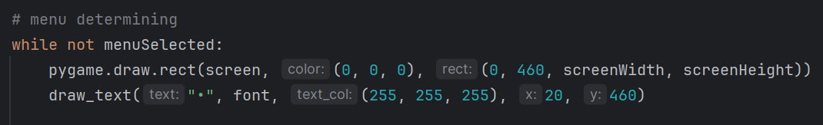
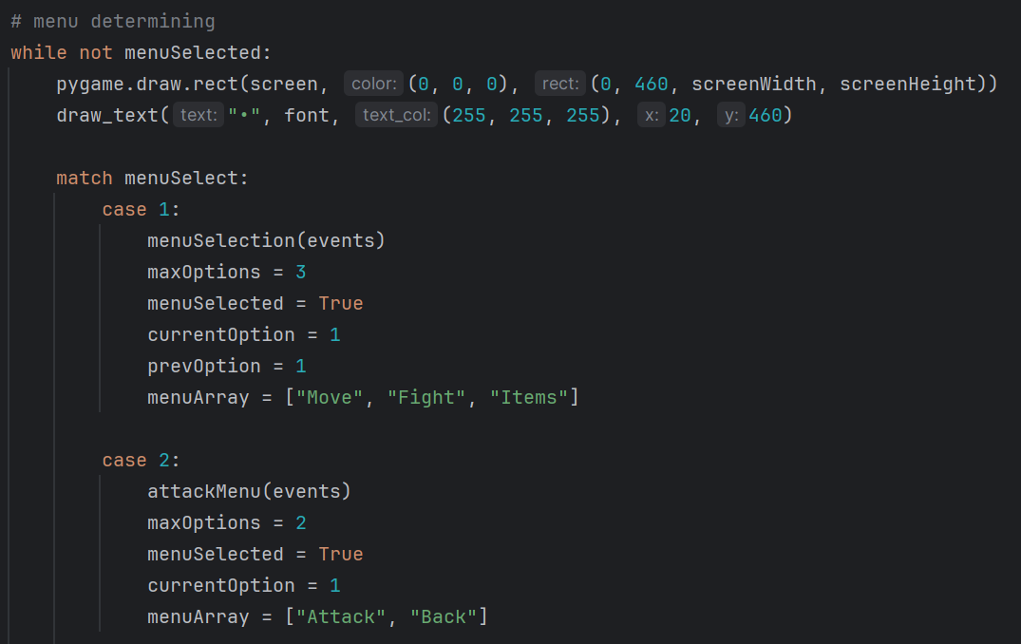
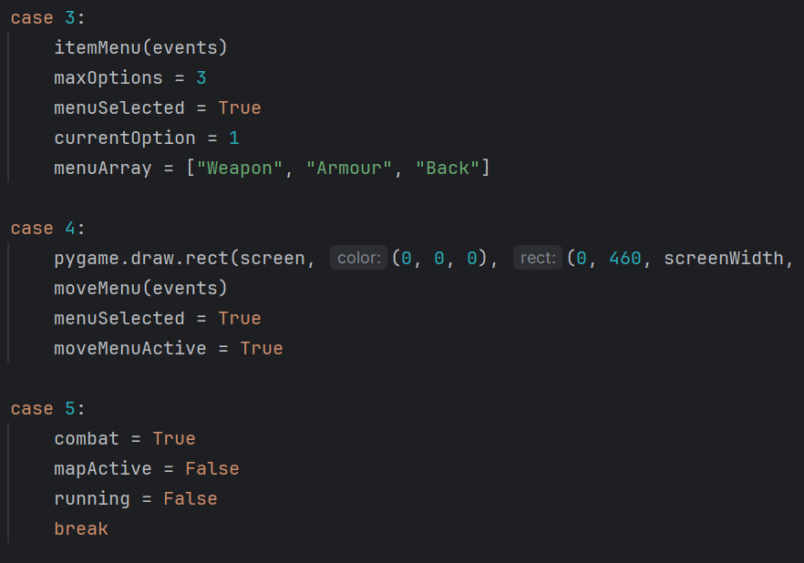
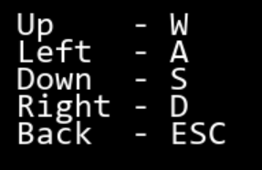
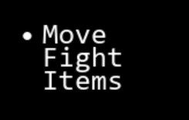
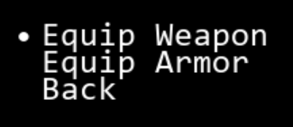

Menu Screen - Drawing and Setting up
Player Input
Changing ‘Selected’ option
Updating the ‘map’
Changing menu

Slide 8
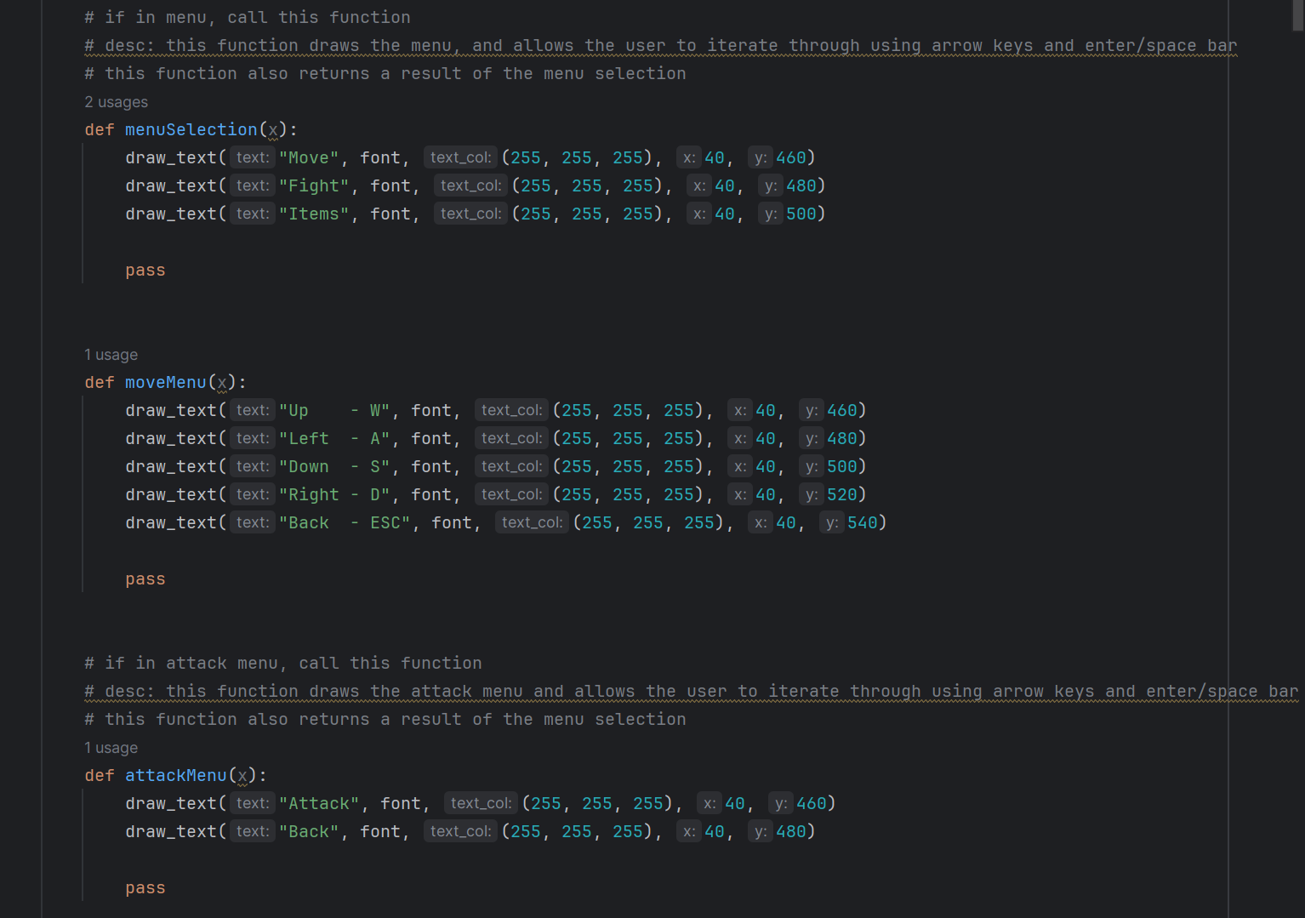
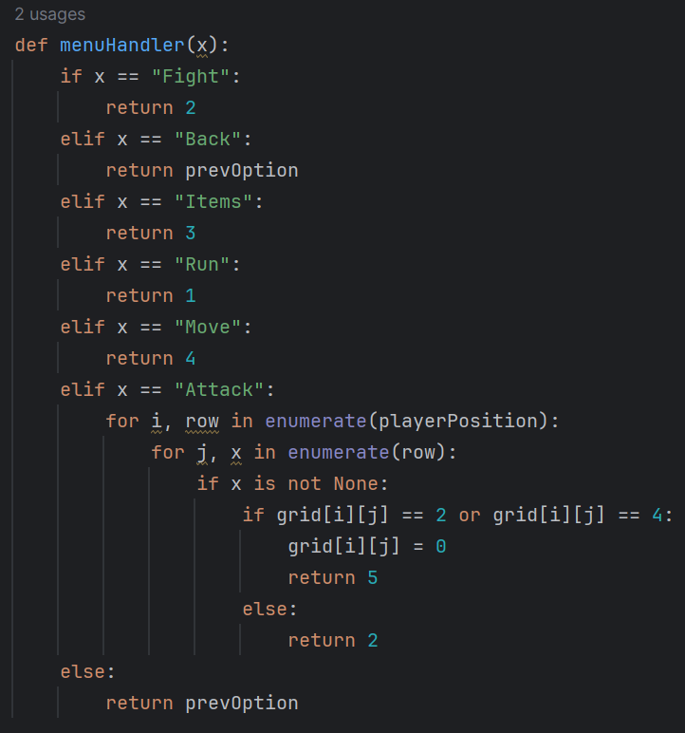
Menu Screen - Functions
Drawing menu, handling menu selections

Slide 9
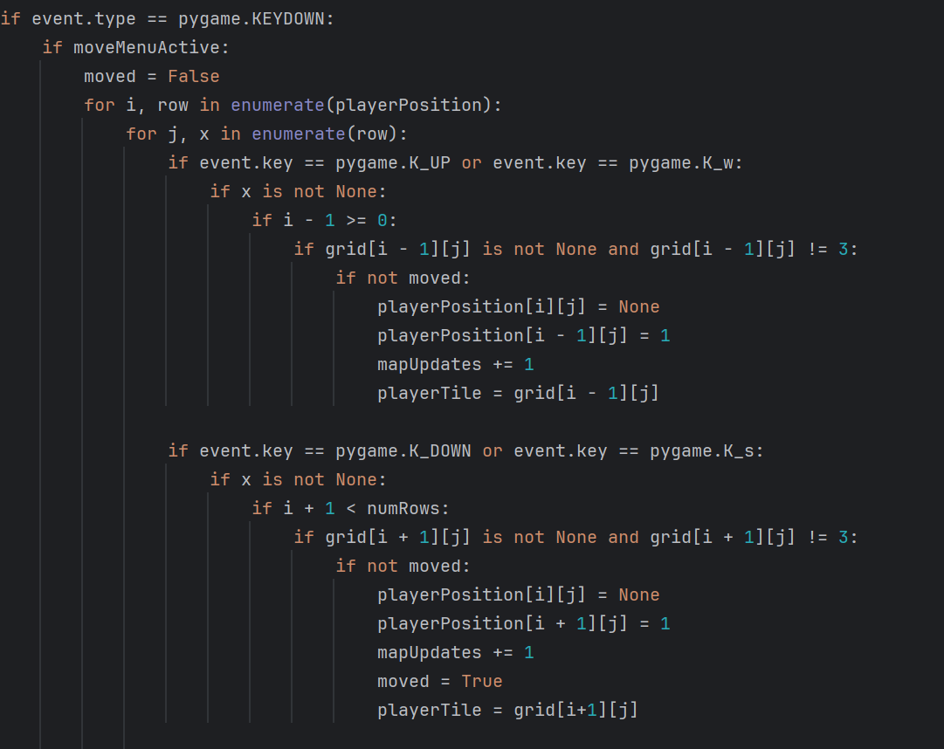
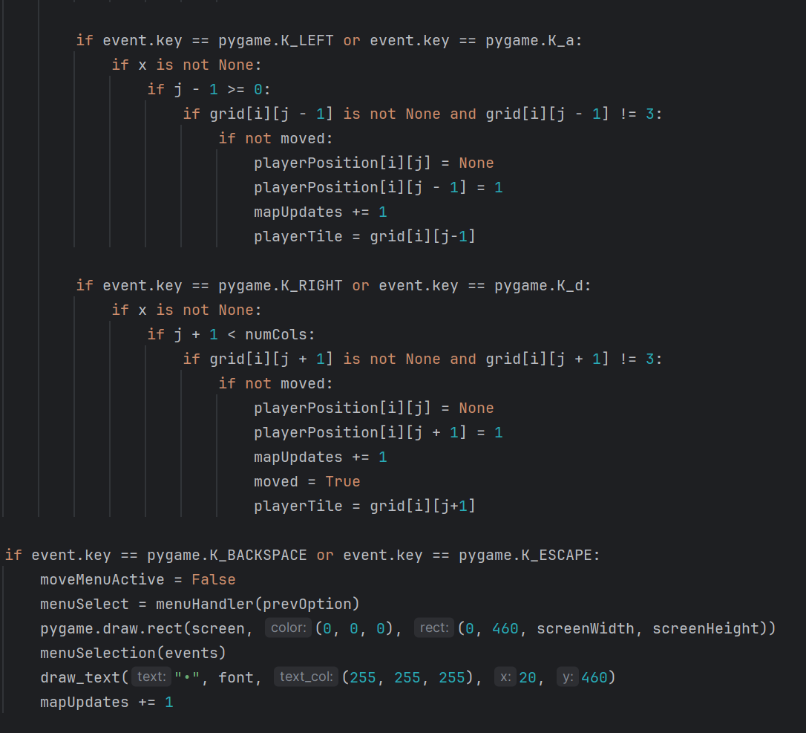
Menu Screen - Movement
Movement Menu
Stopping all other actions & inputs
Checking adjacent tiles
Updating the map
Limiting player moves per event (bugfix)

Slide 10
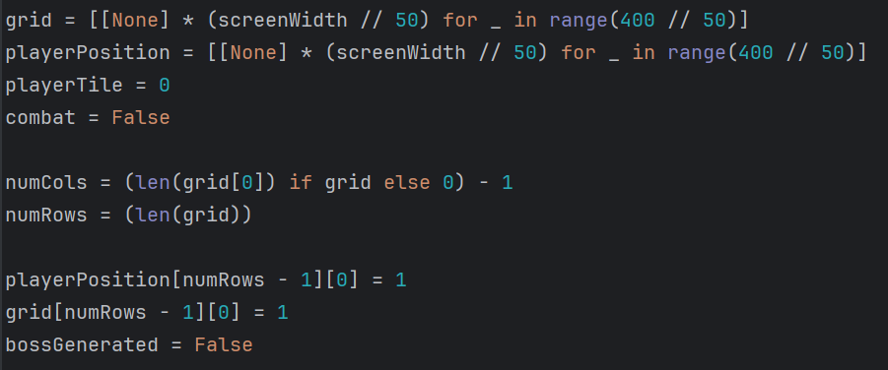
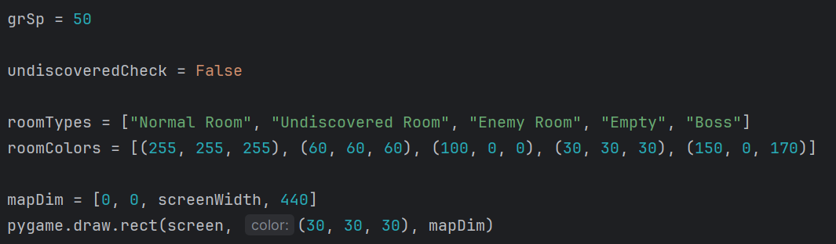
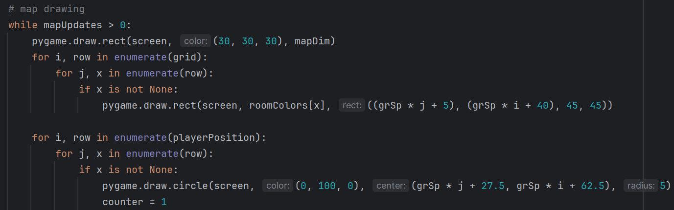

Map Generation - Step 1
Parallel arrays, setting up spacing
Arrays to hold tile types
Specifying map dimensions
5 types of ‘rooms’
Drawing the map using the spacing & pygame functions

Slide 11
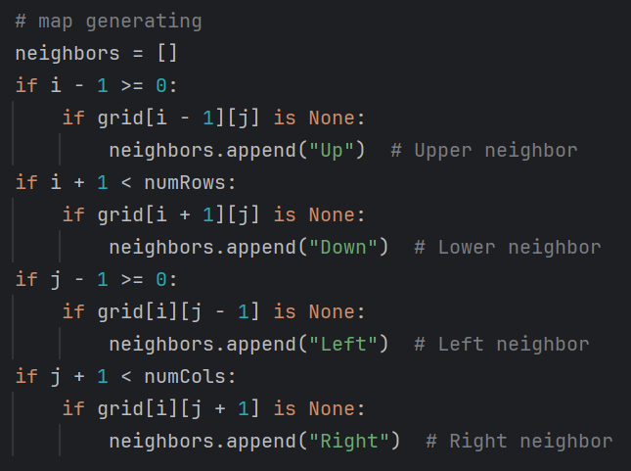
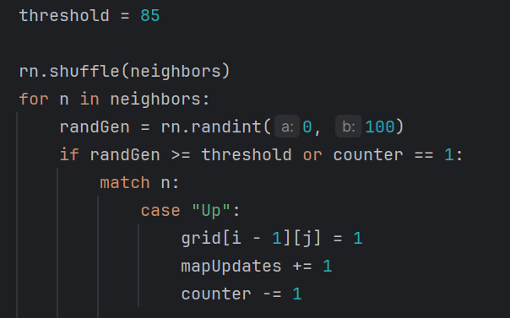
Map Generation - Procedural Content
Simple algorithm - other procedural generation types such as Perlin Noise, fractal generation, L-systems, etc. were too hard to implement in the timeframe given
Checks ‘neighbour’ tiles & appends
Sets a ‘threshold’ for random generation
Shuffles ‘neighbour’ tiles & picks one
If threshold is passed, generate tile
Failsafe added - first tile always generates
For each tile generated, the next tile is less likely to generate (more selective)

Slide 12
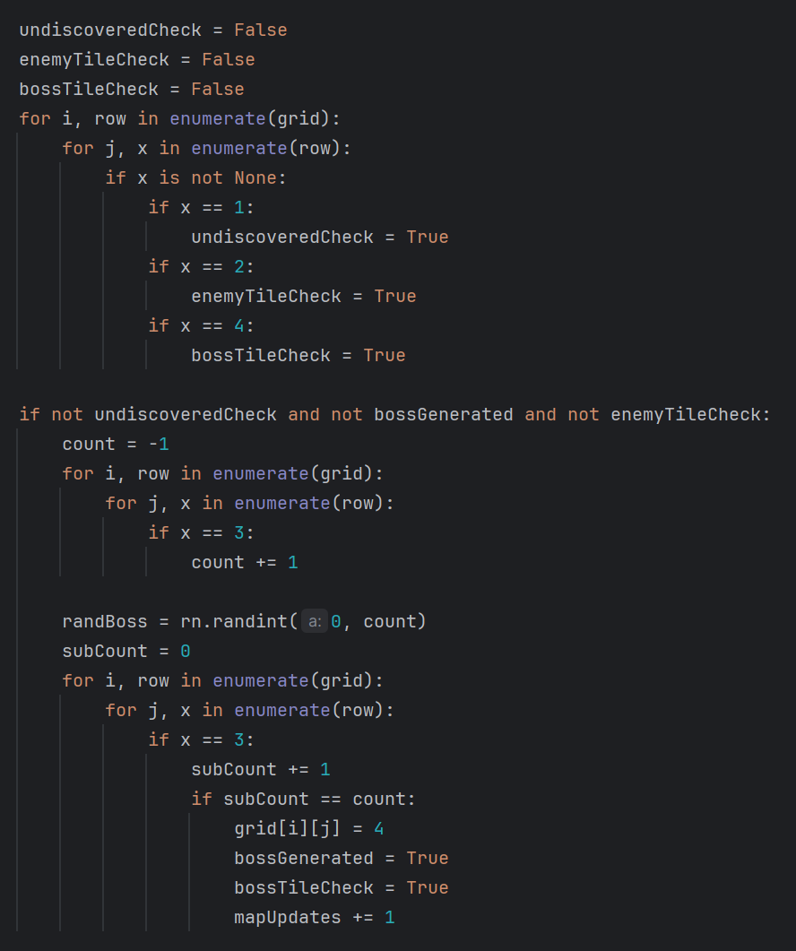
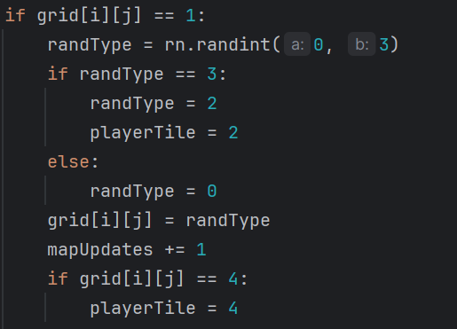
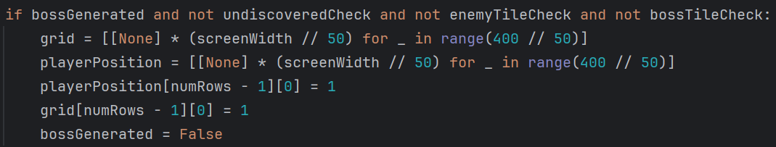
Map Generation - Procedural Content
If player walks onto tile
‘Discover’ the tile, randomly decide if tile is ‘enemy’ or normal tile
If player ‘discovers’ all the tiles
If there are no enemies on the ‘map’
Generate a boss room
Update the ‘map’

Slide 13
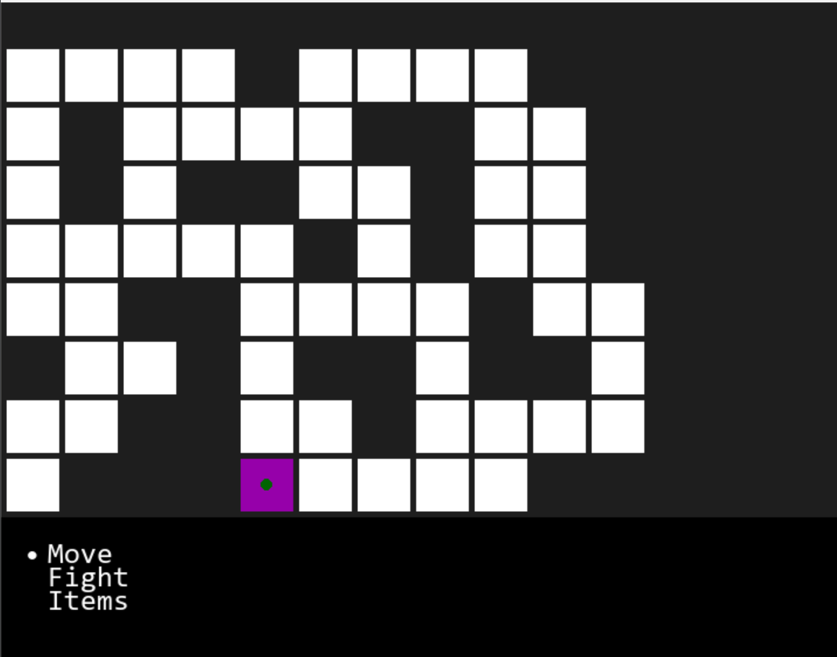
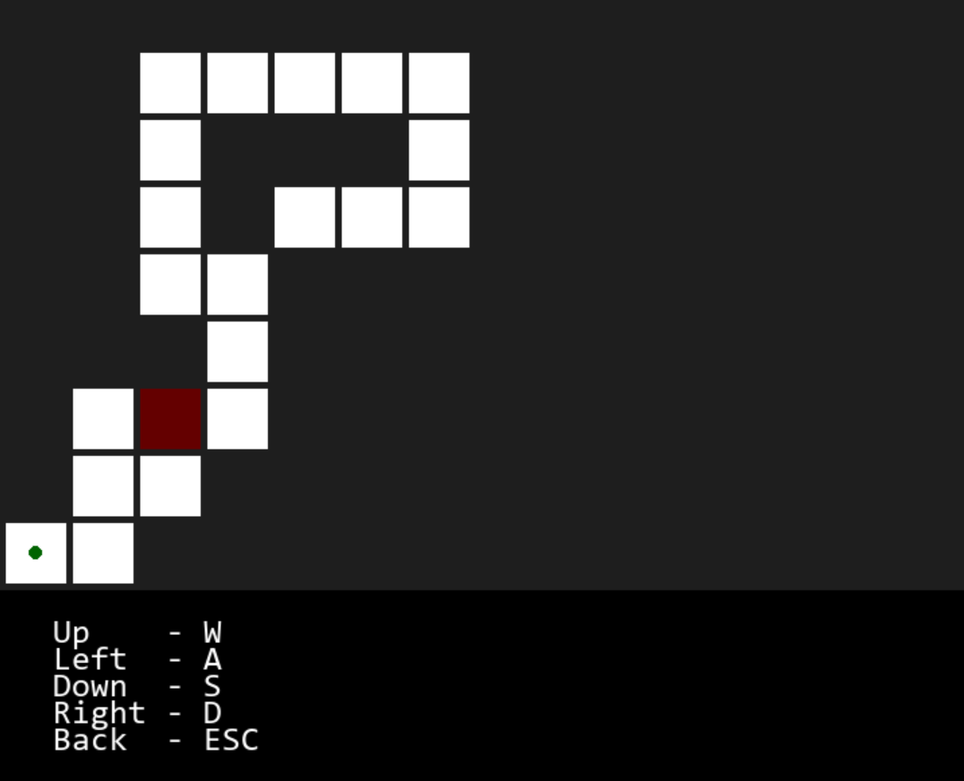
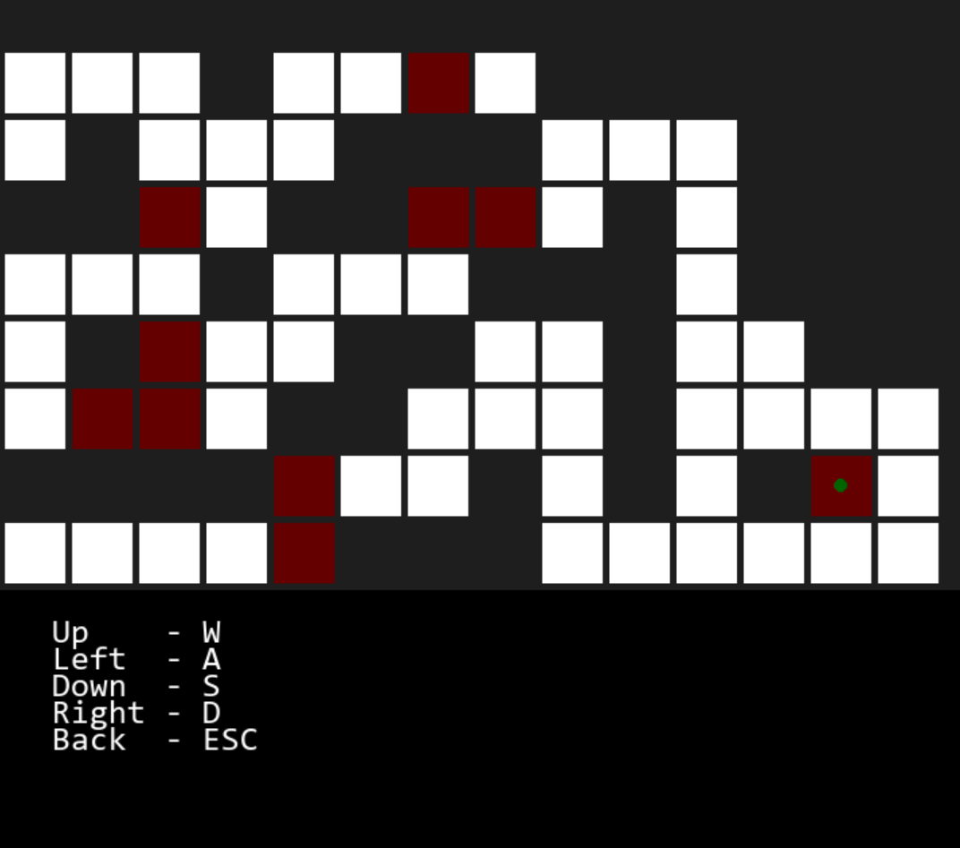
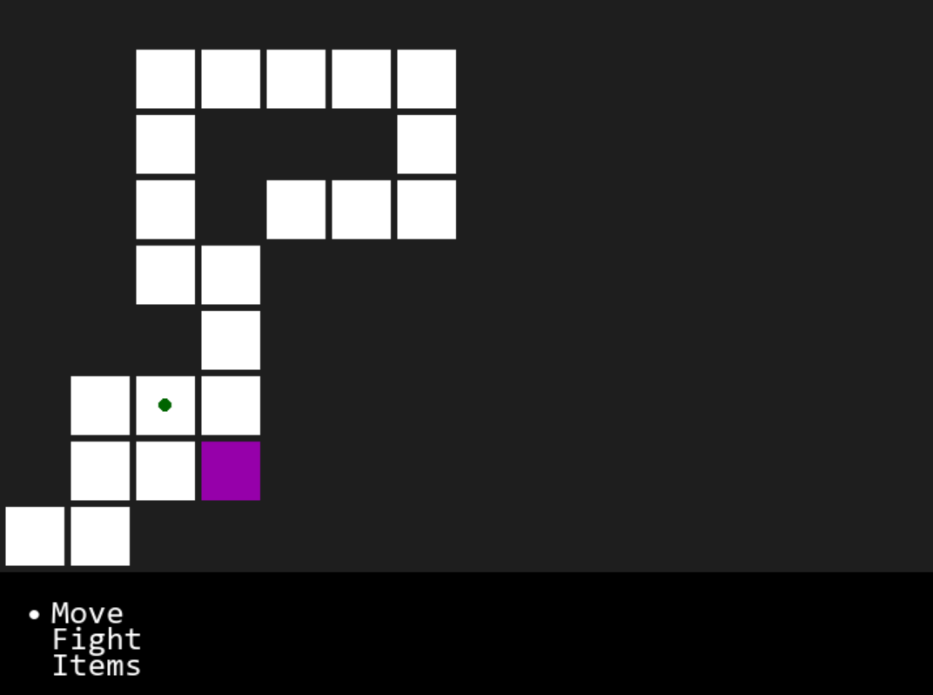
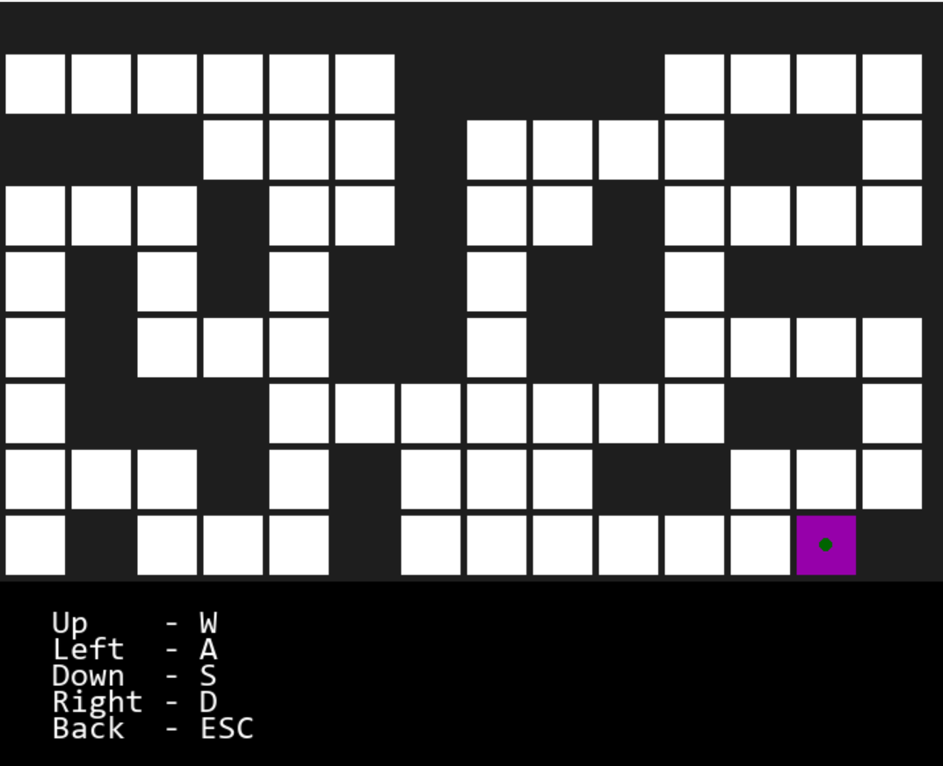
Extras
Put game in a while loop: if the boss is defeated, the game will reset the arrays, and place the player back to first square to replay the game
Not enough time to implement things such as upgrades, harder levels, player performance analysis

Slide 14
Retrospection
- Learnt to work on coding projects with a team
- Learnt to make modular code
- Learnt to integrate other people’s code
- Learnt to apply OOP and Procedural Generation into a game
- Learnt Pygame, and OS
- Learnt to plan out practical coding projects
- Learnt to write research/project report
Limitations and Moving Forward
Player performance analysis was not completed. For programmers planning to continue to the project/prospects for the future of this genre of games, a player performance analysis and a database of weapons, armor, equipment, and monsters would be a step in the right direction

Slide 15
References
Brewer Nathan (2016), ‘Going Rogue: A Brief History of the Computerized Dungeon Crawl’, InSight IEEE USA, https://insight.ieeeusa.org/articles/going-rogue-a-brief-history-of-the-computerized-dungeon-crawl/
Trammell Aaron (2018), ‘Militarism and Masculinity in Dungeons & Dragons’, Masculinities in Play, pp 129-147, https://link.springer.com/chapter/10.1007/978-3-319-90581-5_8
https://www.enworld.org/threads/gaming-with-gygax.204729/
https://www.cdw.com/content/cdw/en/research-hub.html
https://www.shutterstock.com/image-vector/dark-dungeon-long-medieval-castle-corridor-2118070751?irclickid=WBGzch0C8xyKTphylxV-gzUBUkHTuZTH3VKrxc0&irgwc=1&pl=77643-108110&utm_campaign=TinEye&utm_content=108110&utm_medium=Affiliate&utm_source=77643&utm_term=

Slide 16
Thank You, Any Questions?

